Slide 1
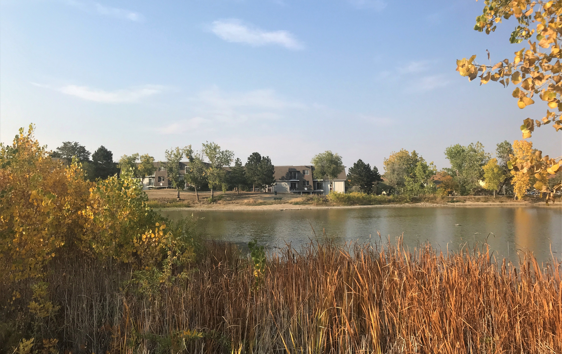
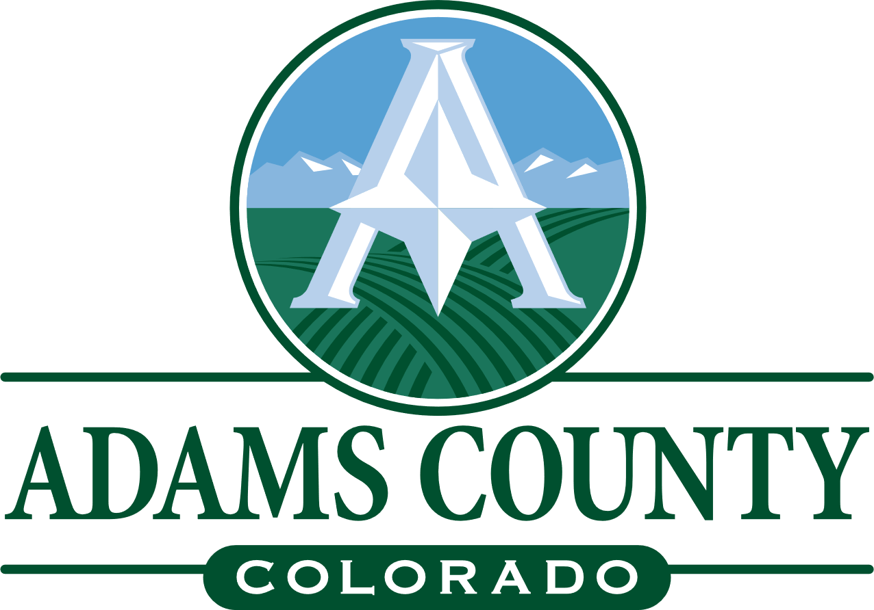
ADAMS COUNTY DEVELOPMENT CODES
Board of County Commissioners Study Session August 10, 2021
PREPARED BY

Slide 2
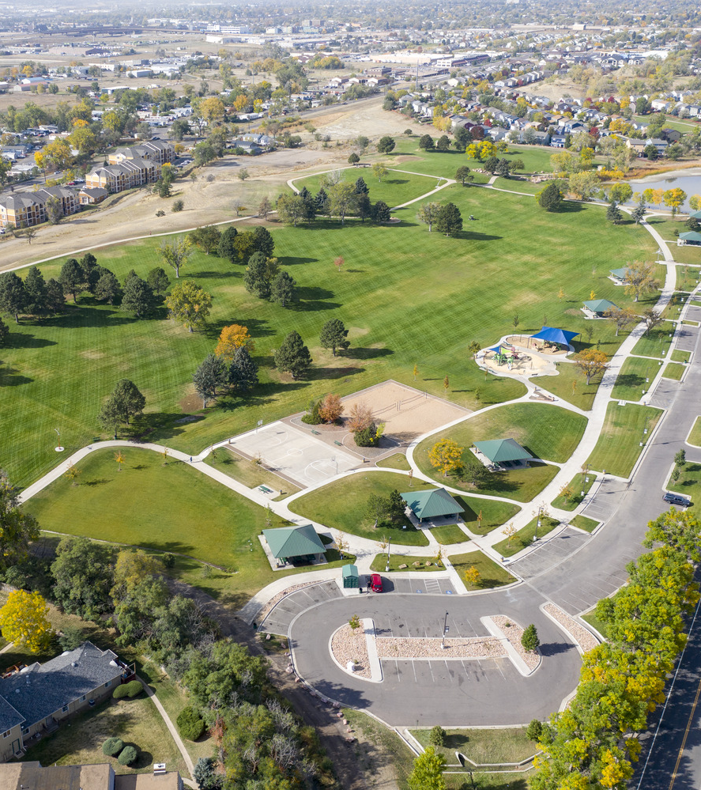
Project Purpose
Review the current and future uses in parks and open spaces in Adams County
Develop new zone district regulations to better address those land uses
Rotella Park
July 20, 2021
ADAMS COUNTY DEVELOPMENT CODES

Slide 3
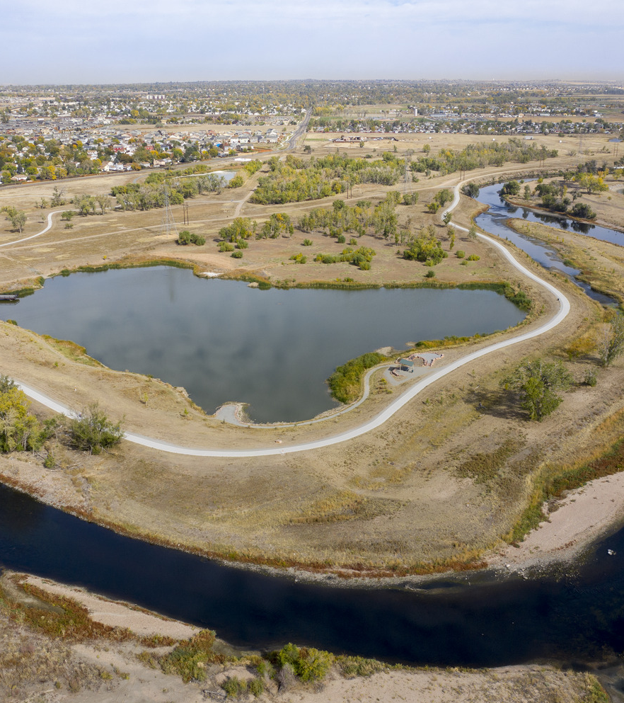
Work Completed to Date
Reviewed Best Practices:
  Boulder
  Arapahoe
  Denver
Drafts:
  New zoning Categories
  New Dimension table/ use tables
Conducted interviews with key stakeholders
  Adams County Special Events Staff
  Parks & Rec Districts
  Splendid Valley District Plan Commission
  Adams County Education Consortium (ACEC)
Pelican Ponds
July 20, 2021
ADAMS COUNTY DEVELOPMENT CODES

Slide 4
Summary of Interview Topics
Create Parks and Open Space Zone Districts
Update Parks Performance Criteria
Update Agriculture Performance Criteria
Address Temporary and Special Uses through the Parks Zone Districts
July 20, 2021
ADAMS COUNTY DEVELOPMENT CODES
Notes:
Review of zoning

Slide 5
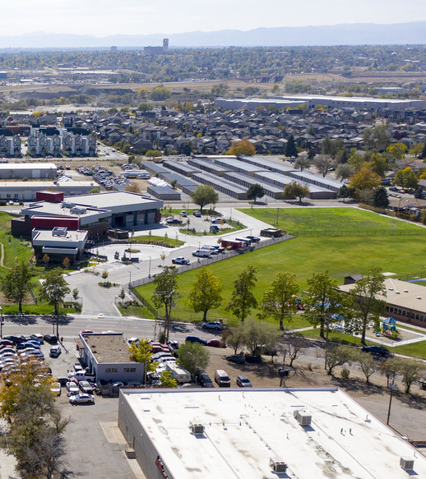
Summary of Stakeholder Interviews
Address different types of spaces (rural versus urban)
Ensure existing uses are allowed
Retain simple process
July 20, 2021
ADAMS COUNTY DEVELOPMENT CODES

Slide 6
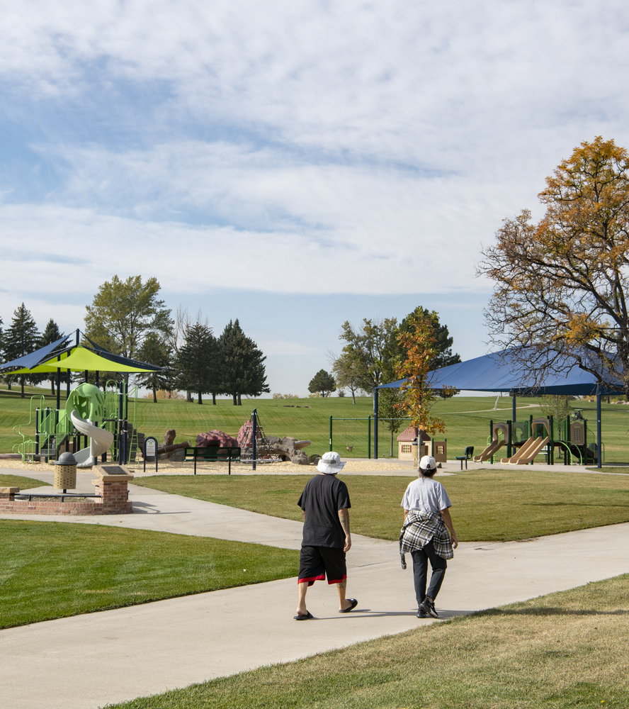
Proposed Code Changes
Proposed 3 open space categories:
  Neighborhood Park
  Regional Park
  Natural Area
Existing and new uses:
  Permitted
  Conditional
  Prohibited
Opportunities to enhance economic vitality
Dimensional requirements
New definitions
Rotella Park
July 20, 2021
ADAMS COUNTY DEVELOPMENT CODES

Slide 7
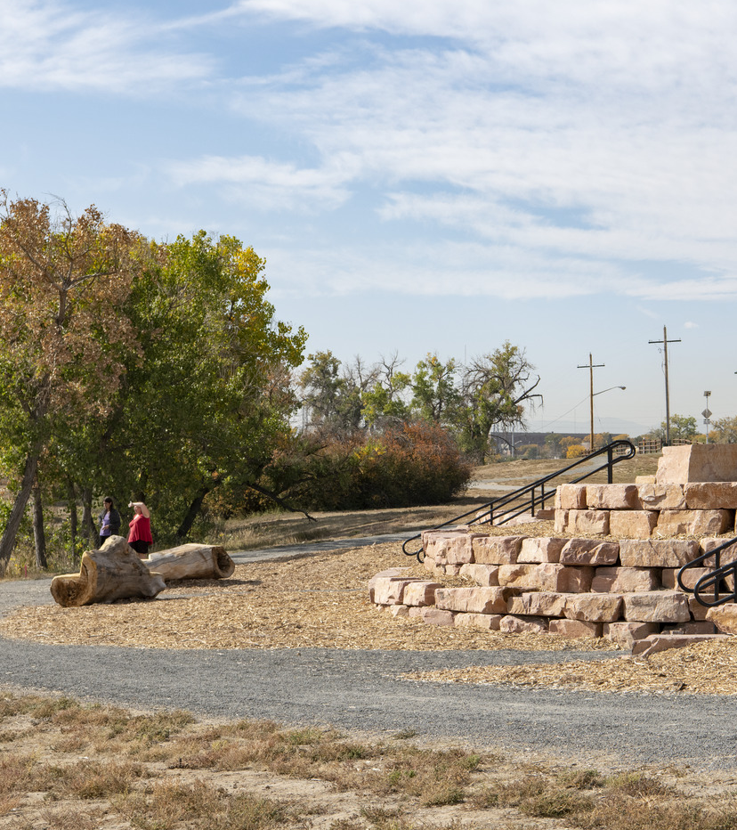
Neighborhood Park
Focused on open space, park, and recreational uses that are compatible in a residential or mixed-use setting.
Active and passive recreational use are permitted.
Neighborhood parks are owned and operated by a public or quasi-public park, open space, or recreation district.
Pelican Ponds
July 20, 2021
ADAMS COUNTY DEVELOPMENT CODES
Notes:
Neighborhood Parks – These would cover smaller parks that tend to serve individual neighborhoods. These could include indoor spaces such as a recreation center, pavilion, and the like.
Regional Parks – These would cover larger parks and open spaces that provide regional benefits. The list of allowed uses could be larger to address the diversity that already exists in Adams County.
Conservation Areas – This zone district would address areas that are intended for very limited development, but could allow some passive recreation opportunities like trails. It could be a new zone district, or an update of the existing Conservation Zone.

Slide 8
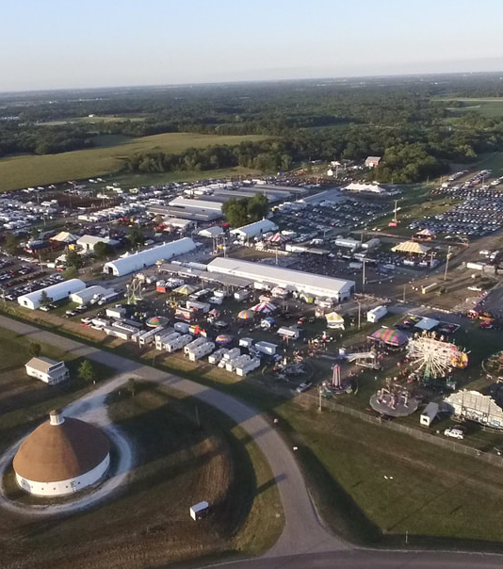
Regional Park
Provide facilities and recreational amenities for a broader area, drawing users from around the region.
Unique uses are appropriate in this zone district, including:
  Fairgrounds
  Agricultural demonstration areas
  Agritourism uses
  Cultural and educational uses.
May protect large areas with natural resource value and of regional importance
Fairgrounds
July 20, 2021
ADAMS COUNTY DEVELOPMENT CODES
Notes:
Neighborhood Parks – These would cover smaller parks that tend to serve individual neighborhoods. These could include indoor spaces such as a recreation center, pavilion, and the like.
Regional Parks – These would cover larger parks and open spaces that provide regional benefits. The list of allowed uses could be larger to address the diversity that already exists in Adams County.
Conservation Areas – This zone district would address areas that are intended for very limited development, but could allow some passive recreation opportunities like trails. It could be a new zone district, or an update of the existing Conservation Zone.

Slide 9
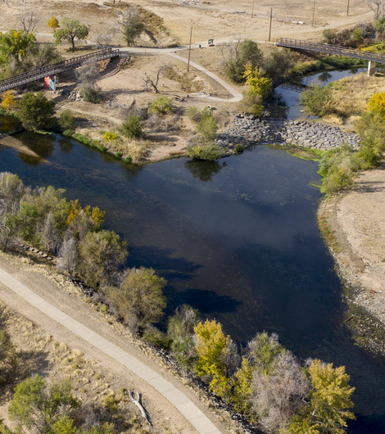
Natural Area
Provide for the preservation of open space and critical natural areas
Lot sizes will vary in this zone district for:
  Effective water conservation
  Land preservation
  Protection of the environment and wildlife
Development and active uses are limited in this zone district
South Platte
July 20, 2021
ADAMS COUNTY DEVELOPMENT CODES
Notes:
Neighborhood Parks – These would cover smaller parks that tend to serve individual neighborhoods. These could include indoor spaces such as a recreation center, pavilion, and the like.
Regional Parks – These would cover larger parks and open spaces that provide regional benefits. The list of allowed uses could be larger to address the diversity that already exists in Adams County.
Conservation Areas – This zone district would address areas that are intended for very limited development, but could allow some passive recreation opportunities like trails. It could be a new zone district, or an update of the existing Conservation Zone.

Slide 10
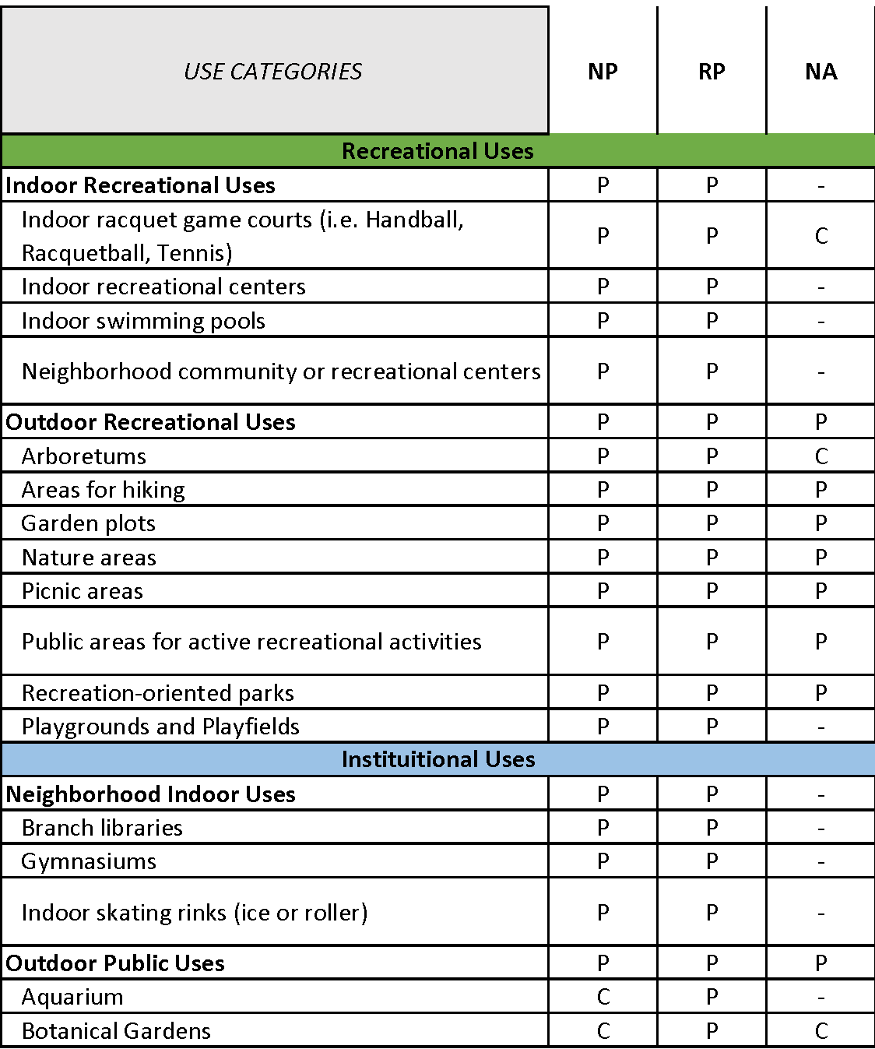
New Uses: Recreational
Created Recreational Uses Category
Consolidated recreational uses
Defined new uses:
  Zoo
  Aquarium
  Agri-Tainment
  Educational tours
July 20, 2021
ADAMS COUNTY DEVELOPMENT CODES
Notes:
Confirm (61/) Full list of Outdoor and Indoor

Slide 11
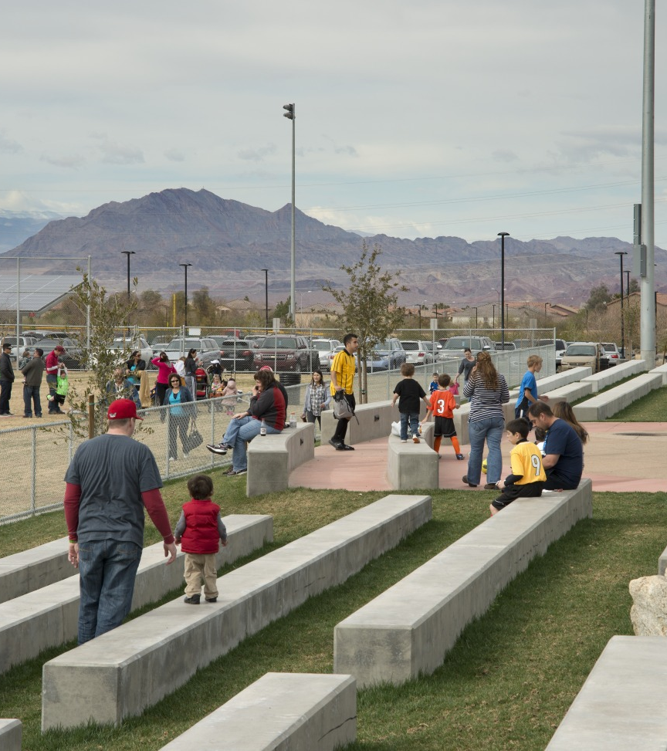
Definition: Recreational Uses
Active and passive recreational services and parcels open to the public.
Recreational Indoor:
  An enclosed facility which offers active recreational opportunities.
Recreational Outdoor:
  An area of facility where any portion of the recreation activity takes places outside.
July 20, 2021
ADAMS COUNTY DEVELOPMENT CODES
Notes:
Add language with indoor and outdoor uses for Recreational Uses

Slide 12
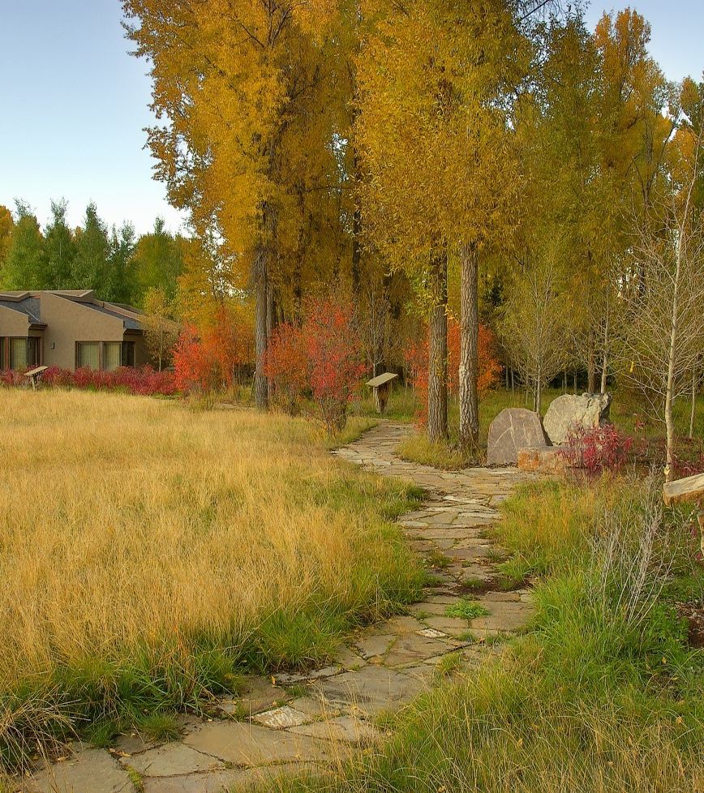
Definition: Agri-Tainment
Supports and enhances agriculture as an attraction for education and entertainment related purposes.
Includes:
  Farm tours
  Educational offerings
  Corn mazes
  Interactive animal displays
July 20, 2021
ADAMS COUNTY DEVELOPMENT CODES

Slide 13
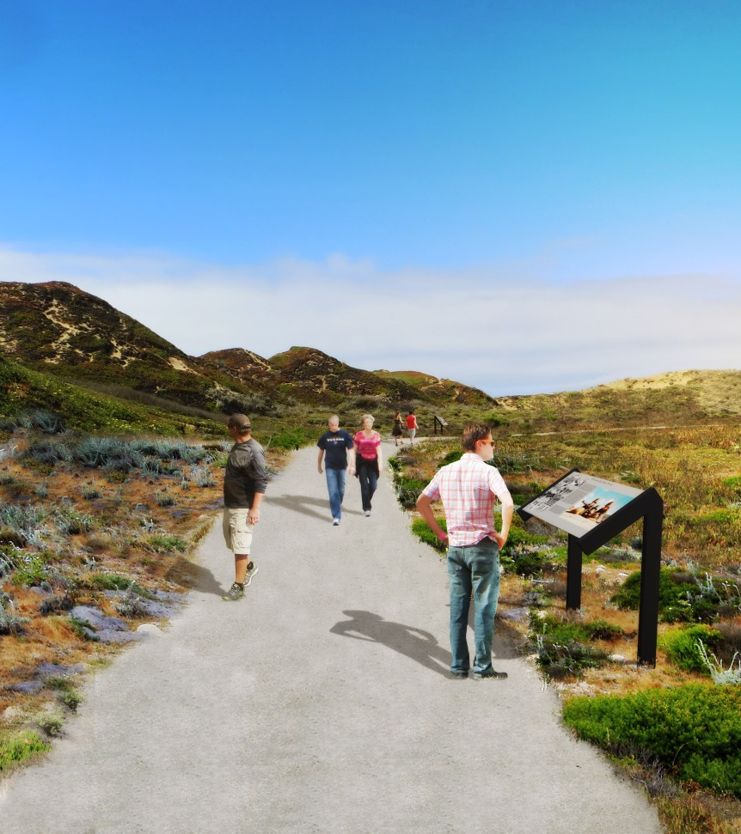
Definition: Educational Tours
Provides hand-on learning opportunities to a place away from normal studies
To provide an experience outside of classrooms or labs.
July 20, 2021
ADAMS COUNTY DEVELOPMENT CODES

Slide 14
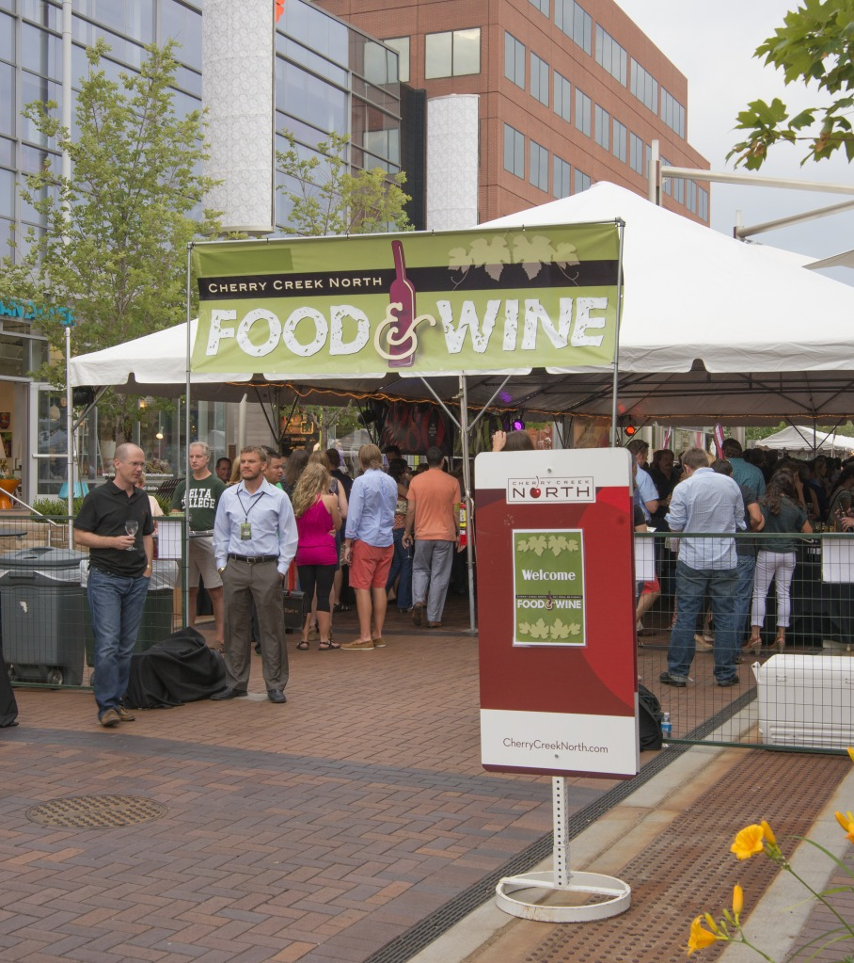
Incidental Sales (definition)
Sales of food on premises where food sales are not the primary reason to frequent the establishment.
Gives opportunities to increase revenue
July 20, 2021
ADAMS COUNTY DEVELOPMENT CODES

Slide 15
Recreational Performance Standards
Variable height in each categories ranging between sixty (60)- ninety-six (96) inches
Development near parks shall maintain the landscape character of the existing park
Added standards to include Educational Tours, Agri-tourism
Height
Aesthetics
Tourism
July 20, 2021
ADAMS COUNTY DEVELOPMENT CODES

Slide 16
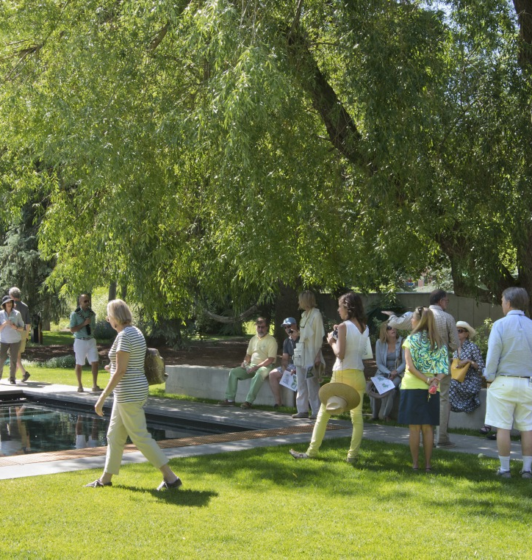
Performance Standards: Educational Tours
Incidental Use: Shall be clearly incidental and secondary to parcel
Activities: Tours may be conducted by foot, bike, tractor, animal, and/or other means.
Employees: Completed by staff working on the parcel, or outside groups.
No Outdoor Storage
No Offensive Impacts
July 20, 2021
ADAMS COUNTY DEVELOPMENT CODES
Notes:
Add images

Slide 17
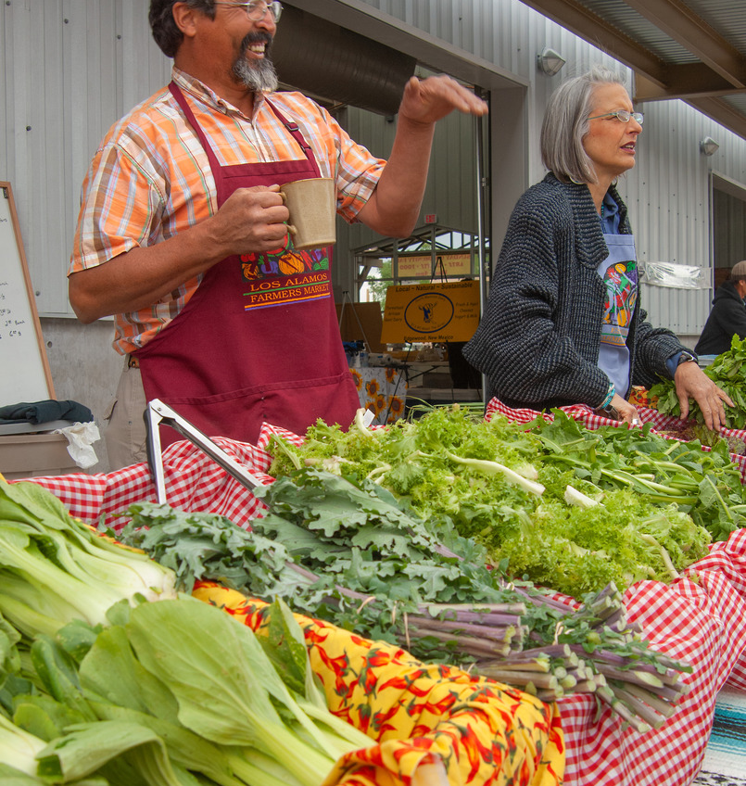
Performance standards: Agri-Tourism
Incidental Use: Shall not change the character of the parcel.
Activities: Tours may be conducted by foot, bike, tractor, animal, and the like.
Employees: May be conducted by staff or outside groups with owner permission.
No Outdoor Storage
No Offensive Impacts
July 20, 2021
ADAMS COUNTY DEVELOPMENT CODES
Notes:
Add images

Slide 18
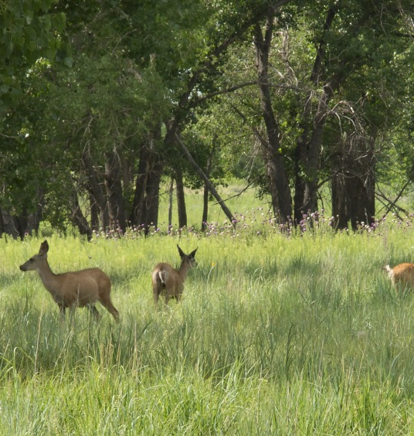
Performance standards: Animal-Related Uses
Property owners who develop near existing park shall maintain landscape character of existing park use.
Aquarium and Botanical: 5 acres
Wildlife Preserve: 35 acres
Zoo: 10 acres
No Outdoor Storage
No Offensive Impacts
July 20, 2021
ADAMS COUNTY DEVELOPMENT CODES
Notes:
Add images

Slide 19
Acreage Case Study (Animal Related Uses)
Standards for Lot Minimum - Case Studies
Type | Name | Location | Lot Size
Aquarium | Downtown Aquarium | Denver | 17- acres
Botanical | Butterfly Pavilion | Westminster | 11-acres
Wildlife Preserve | Rocky Mountain Arsenal | Commerce City | 15,988-acres
Wildlife Preserve | The Wild Animal Sanctuary | Keenesburg | 789-acres
Wildlife Preserve | Two Ponds National Wildlife Refuge | Arvada | 72-acres
Wildlife Preserve | Cucumber Gulch Wildlife Preserve | Breckenridge | 52-acres
Zoo | Denver Zoo | Denver | 80- acres
July 20, 2021
ADAMS COUNTY DEVELOPMENT CODES
Notes:
Add images

Slide 20
Looking Forward
Public comment period ending
Public Hearing and Adoption
Finalization of Code Language
1
2
3
July 20, 2021
ADAMS COUNTY DEVELOPMENT CODES

Slide 21
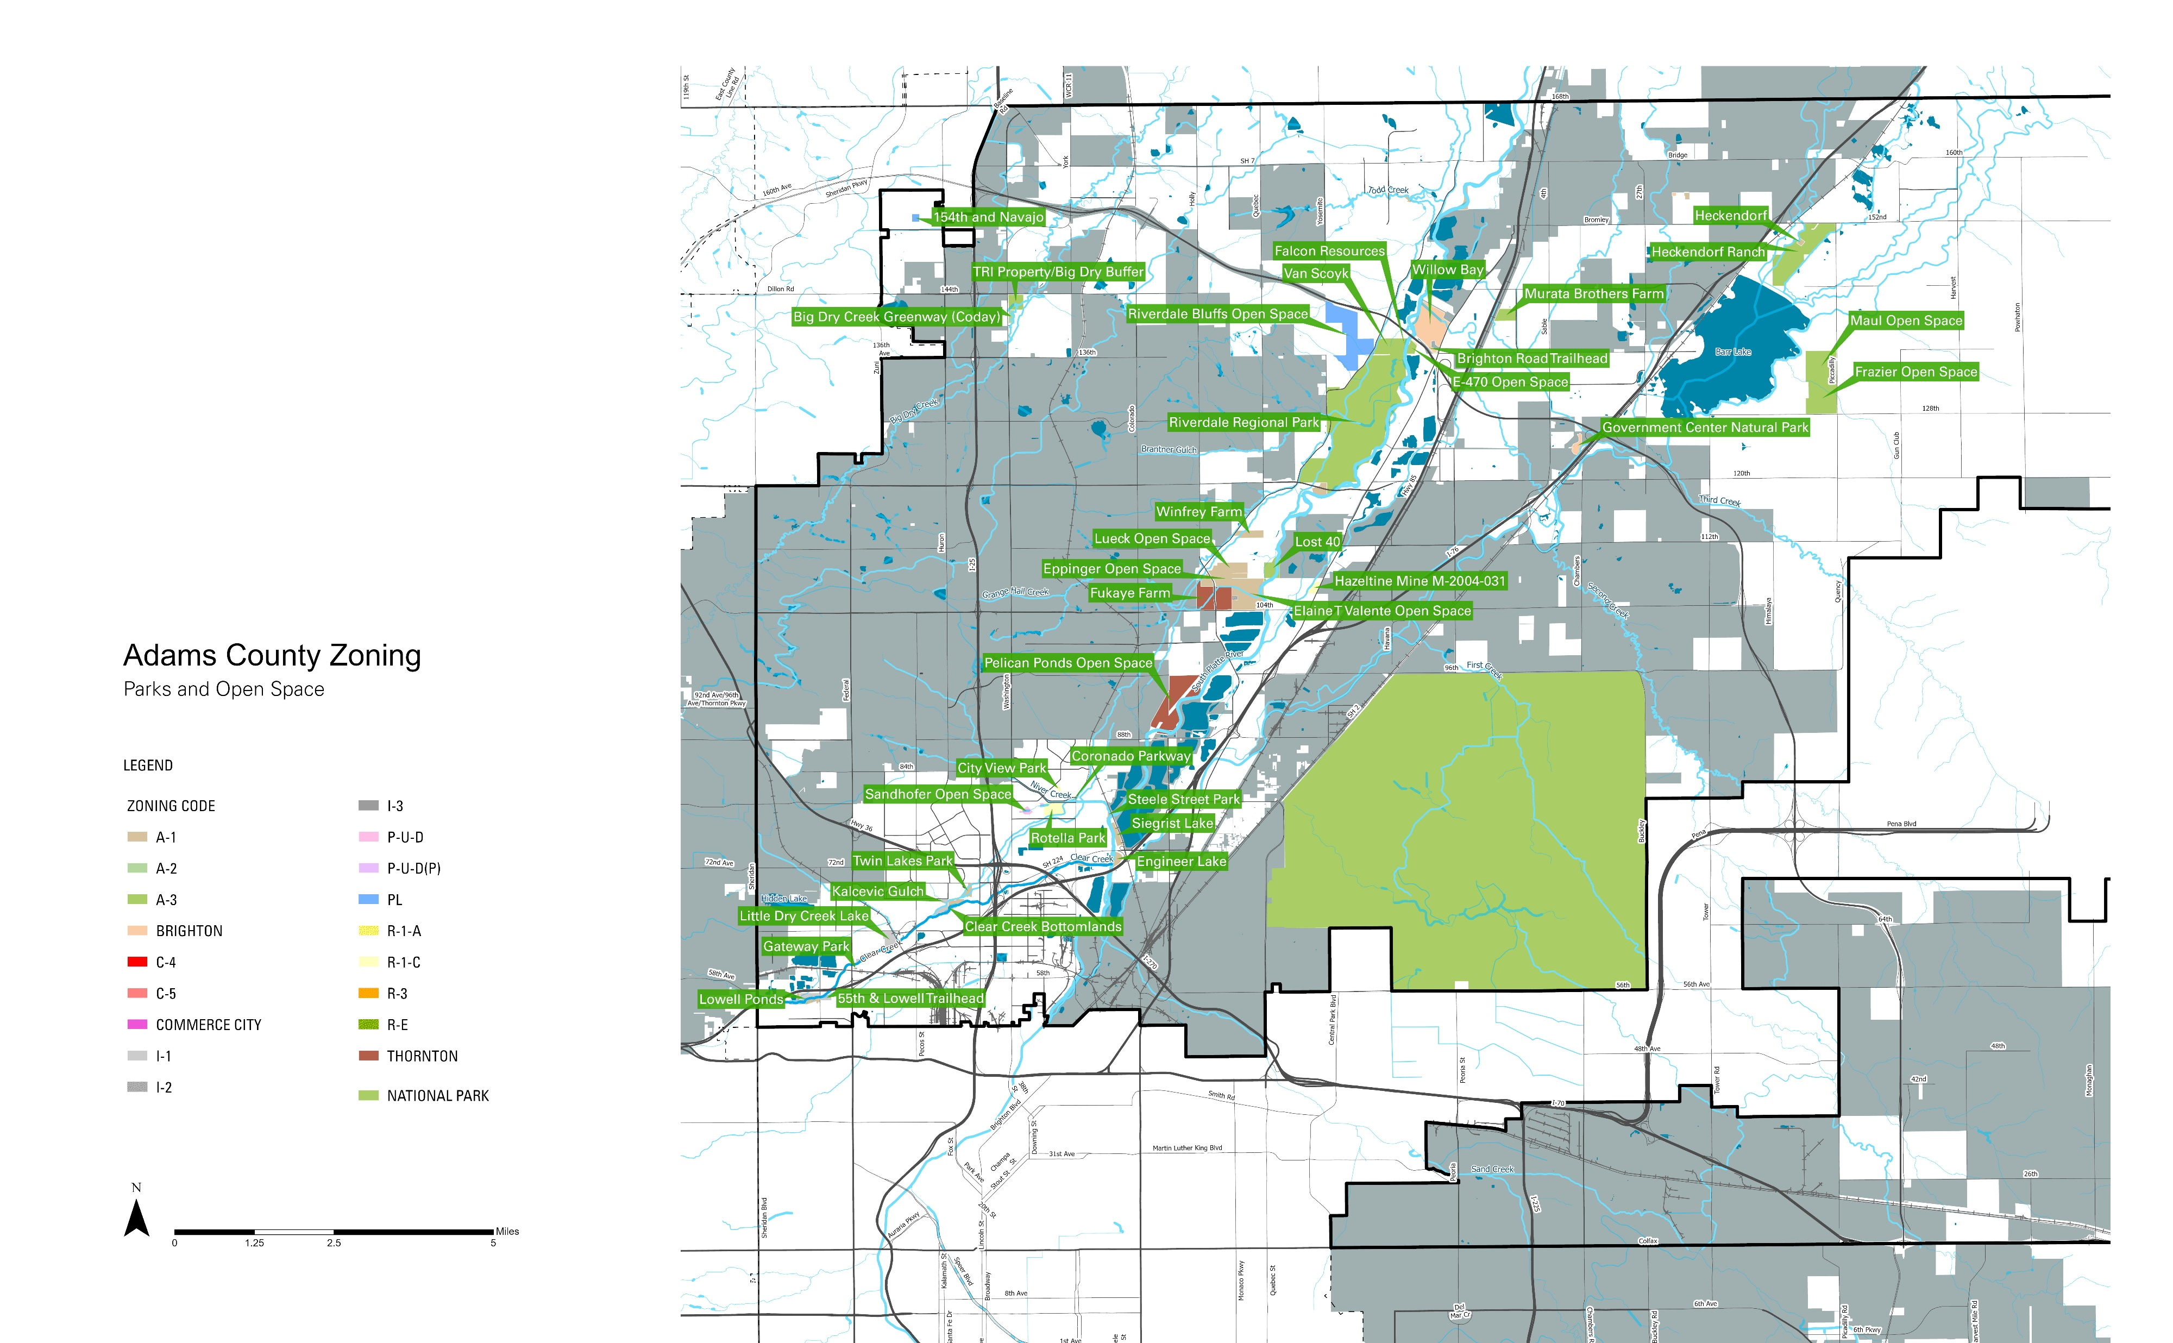
Existing Parks & Open Space Zoning
June 18, 2021
ADAMS COUNTY DEVELOPMENT CODES

Slide 22
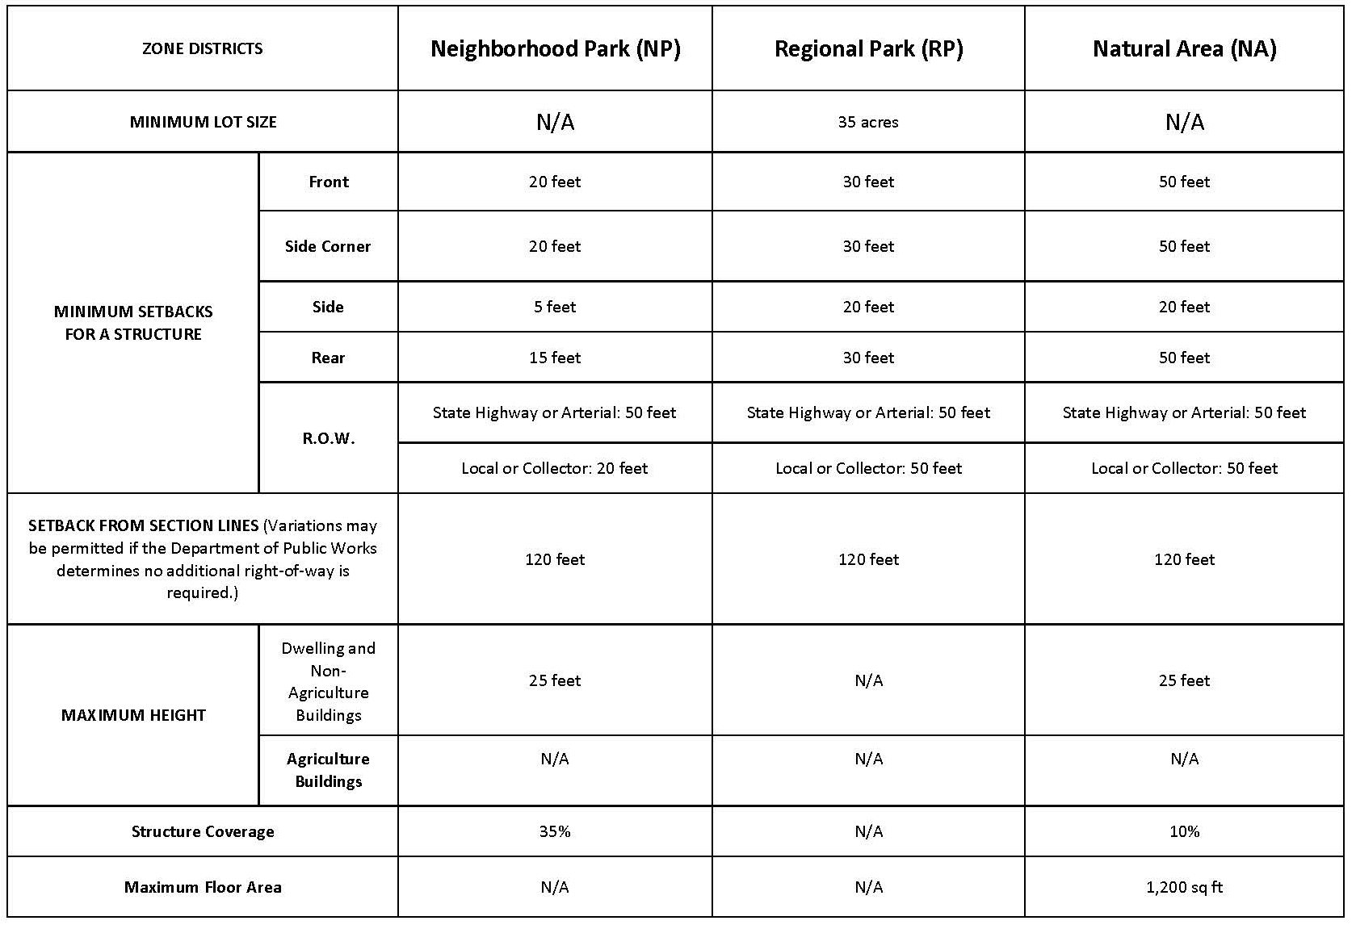
Dimension Table
July 20, 2021
ADAMS COUNTY DEVELOPMENT CODES
Notes:
Neighborhood Parks – These would cover smaller parks that tend to serve individual neighborhoods. These could include indoor spaces such as a recreation center, pavilion, and the like.
Regional Parks – These would cover larger parks and open spaces that provide regional benefits. The list of allowed uses could be larger to address the diversity that already exists in Adams County.
Conservation Areas – This zone district would address areas that are intended for very limited development, but could allow some passive recreation opportunities like trails. It could be a new zone district, or an update of the existing Conservation Zone.

Slide 23
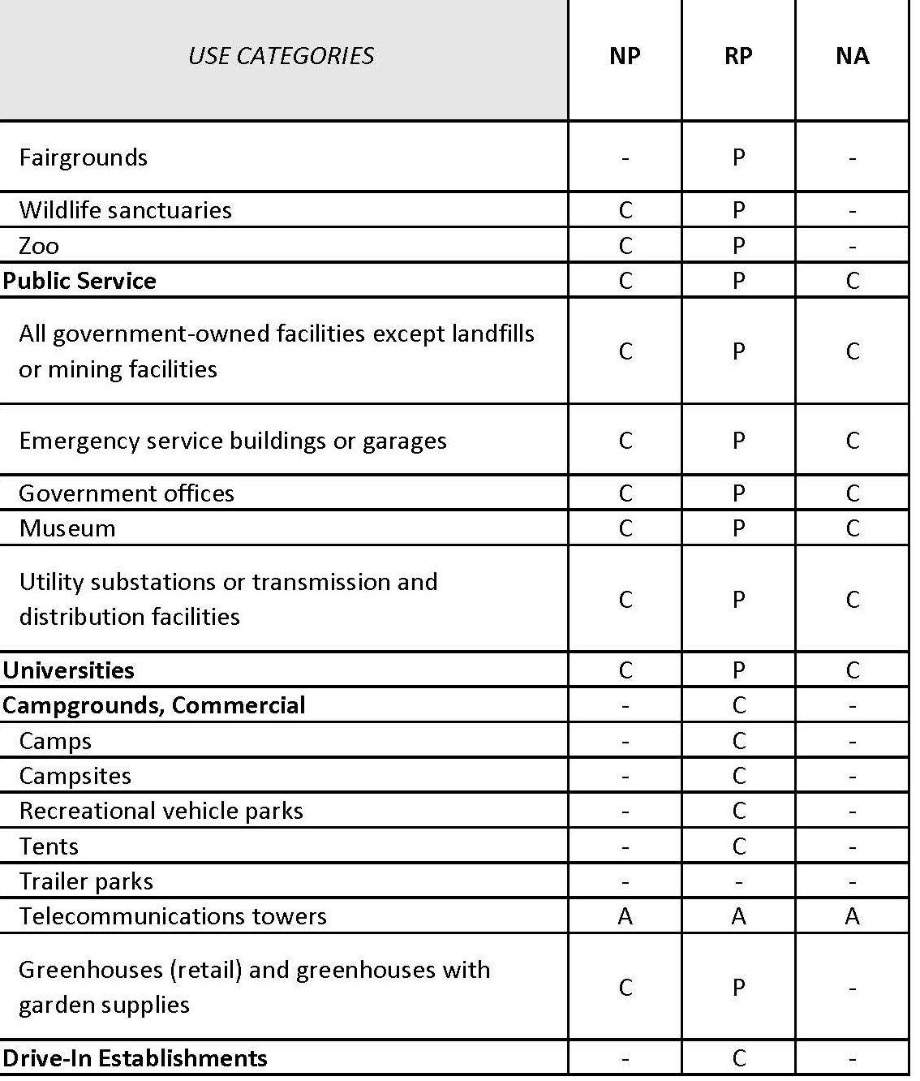
New Use Categories
July 20, 2021
ADAMS COUNTY DEVELOPMENT CODES
Notes:
Confirm (61/) Full list of Outdoor and Indoor

Slide 24
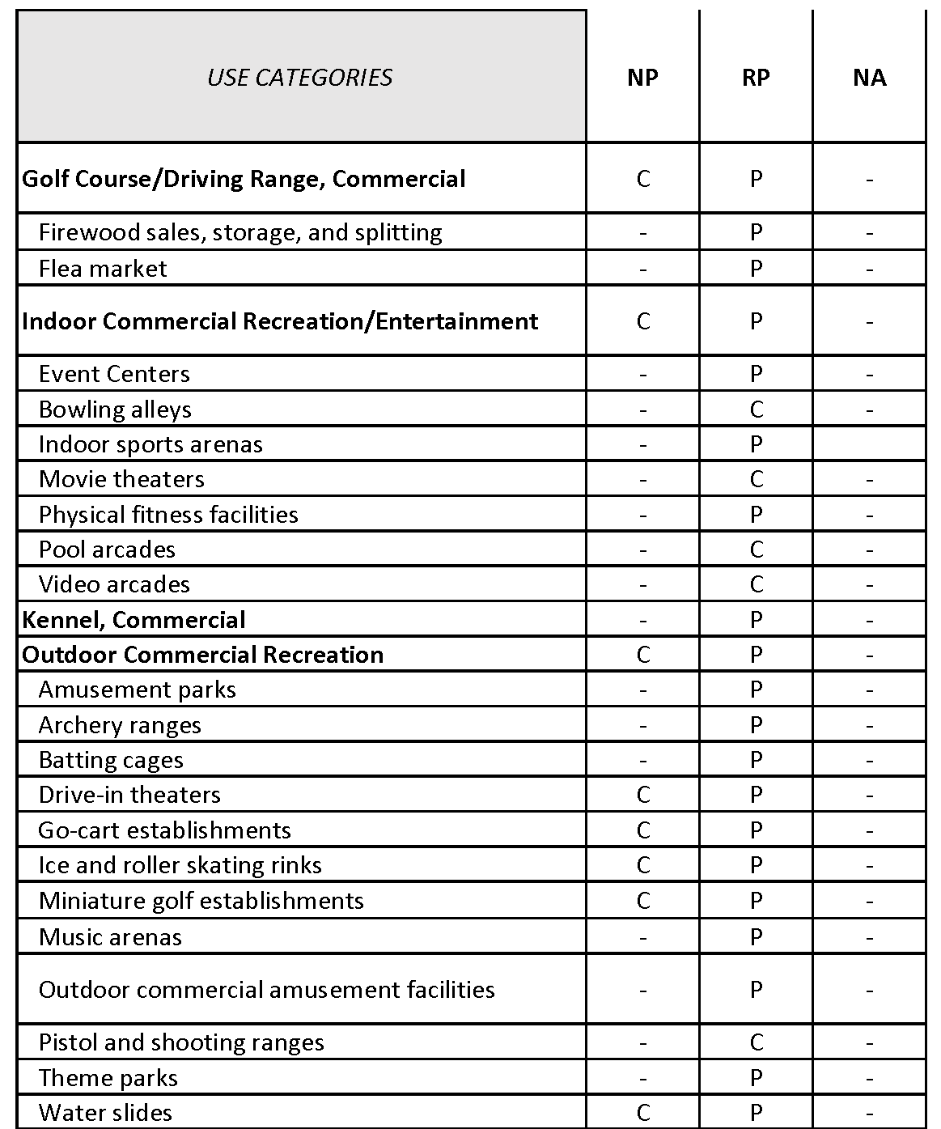
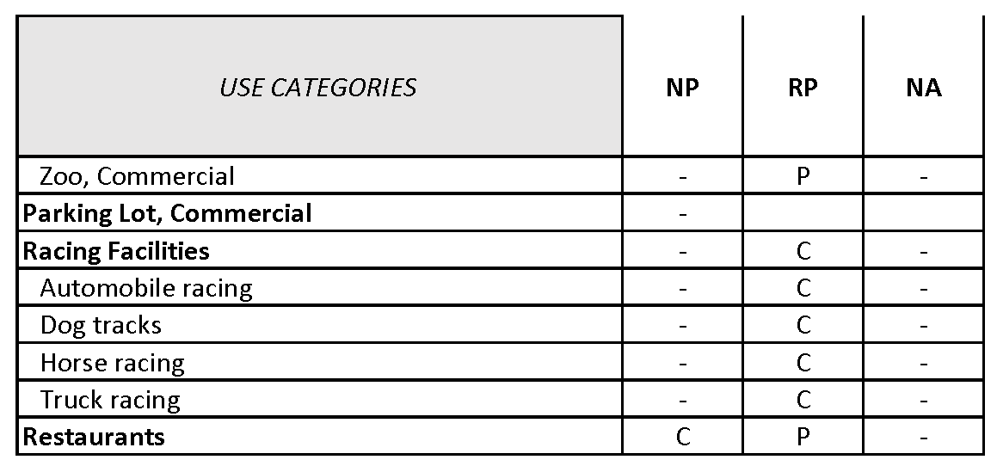
New Use Categories
July 20, 2021
ADAMS COUNTY DEVELOPMENT CODES
Notes:
Confirm (61/) Full list of Outdoor and Indoor

