Slide 1


W. 70TH AVENUE: PECOS ST TO BROADWAY
Public Meeting #2
April 12, 2022
4-6pm

Slide 2
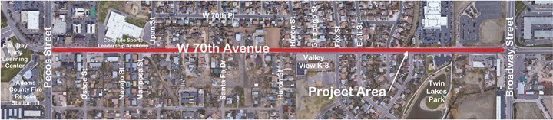
Project Location

Slide 3
Project Overview
Road improvement on W. 70th Avenue
Pecos Street to Broadway
Improvements for bicyclists, pedestrians, transit users and drivers
Safety and mobility
Increasing accessibility and neighborhood connections

Slide 4
Progress to Date
Stakeholder Input #1
Existing Conditions Assessment and Visioning
Stakeholder Input #2
Review Design Alternatives
Public Input #2
Review Design Alternatives
October 2021
Site walk
20+ Stakeholders
November 2021
Virtual open house
16 ‘attendees’
March 2022
Virtual presentation
Stakeholder discussion
April 2022
In-person open house
And online survey
Public Input #1
Existing Conditions Assessment and Visioning

Slide 5
Next Steps
Public Input #3
Review Preferred Alternative
Final Right of Way Plans
Final Design
Construction
Fall 2022
In-person
Winter 2023
Winter 2023
Summer 2024
Fall 2022
In-person
Stakeholder Input #3
Review Preferred Alternative

Slide 6
Feedback Received: Virtual Open House

Slide 7
Feedback Received: Virtual Open House
Safety at Intersections

Slide 8
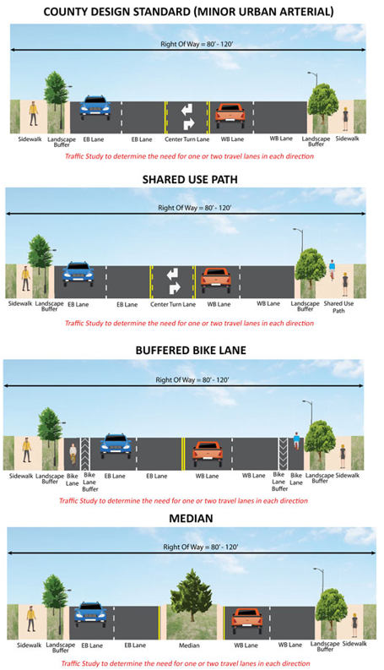
Feedback Received: Virtual Open House

Slide 9
Feedback Received: Email/Social Media
Email:
Speeding is an issue, particularly between Huron St and Kidder Dr
Consider a traffic signal at 70th and Lipan
Weight restriction needs to be enforced, install better signage for weight limits, reduce double left turns at 70th and Pecos, truck loads need to be covered
Social media:
Prioritize safe space for bicyclists

Slide 10
Existing Conditions (“No Build”)
Characteristics
Minimal/no shoulders in middle section
No sidewalks in middle section
Sidewalks don’t meet current standards (5’)
No bicycle facilities
This alternative serves as a baseline for comparison with the Build Alternatives.
It will not have any safety and mobility improvements for the pedestrian, bicyclists and motorists. Therefore, it does not meet the County’s standards.

Slide 11
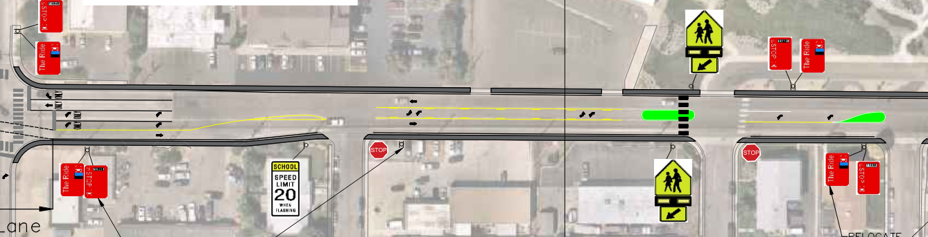
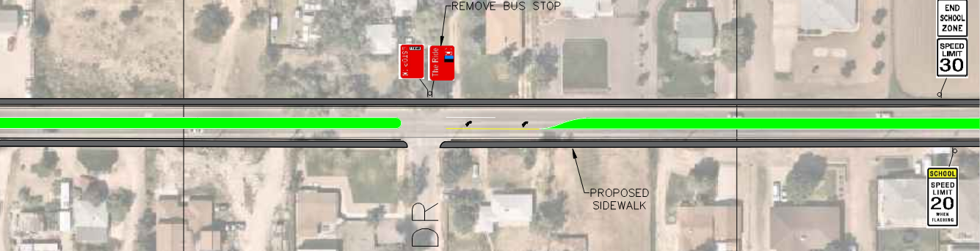
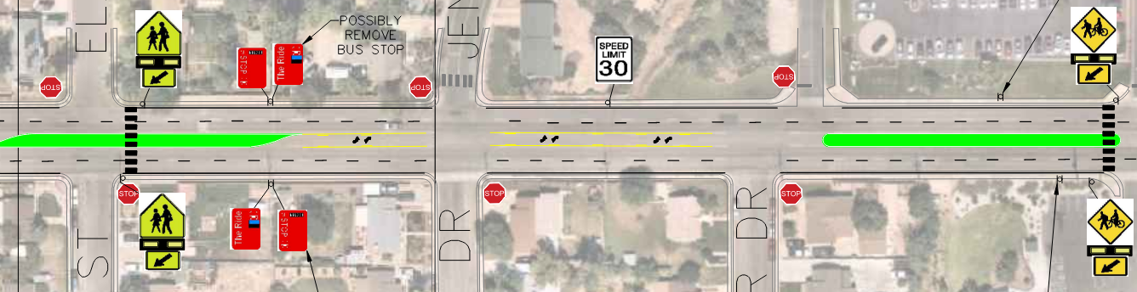
Alternative 1 3-Lane Section, Median/Center Turn Lane
Pecos – Lipan Lipan - Huron
Huron - Broadway

Slide 12
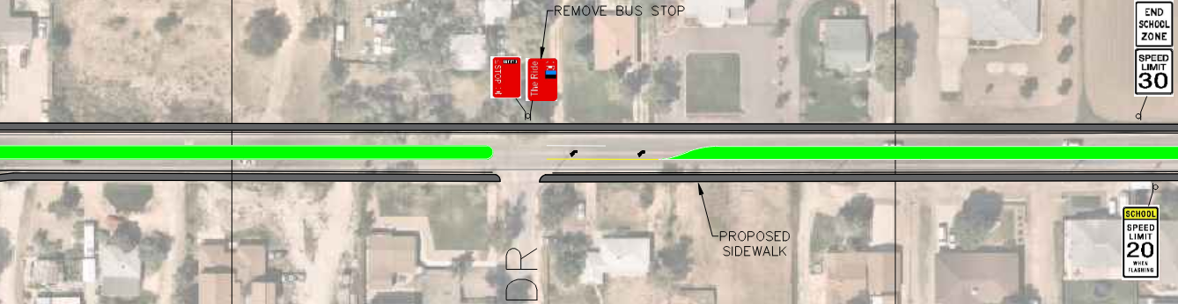
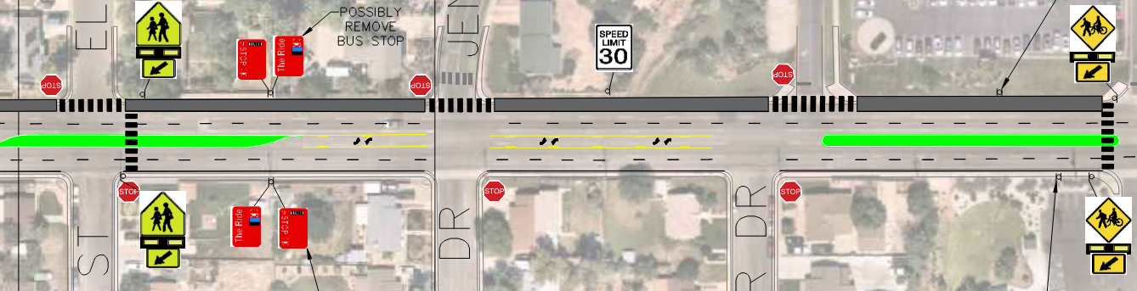
Alternative 1A 3-Lane Section, Median/Center Turn Lane and Sidewalk Widening/Shared Use Path
Pecos – Lipan Lipan – Huron
Huron - Broadway

Slide 13
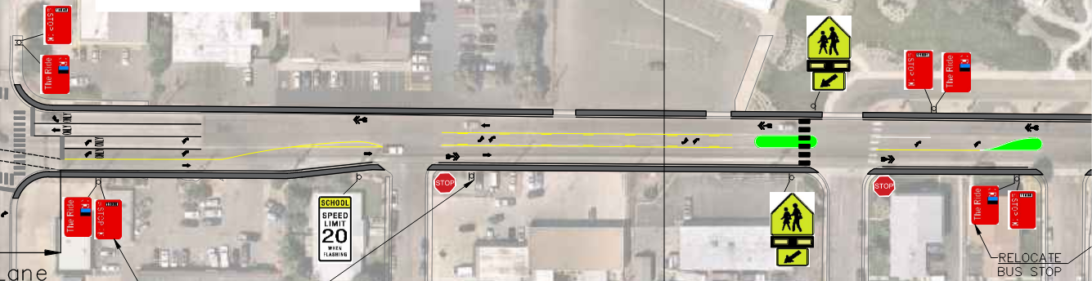
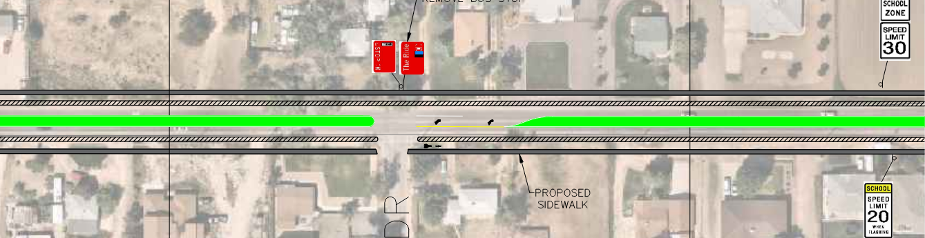
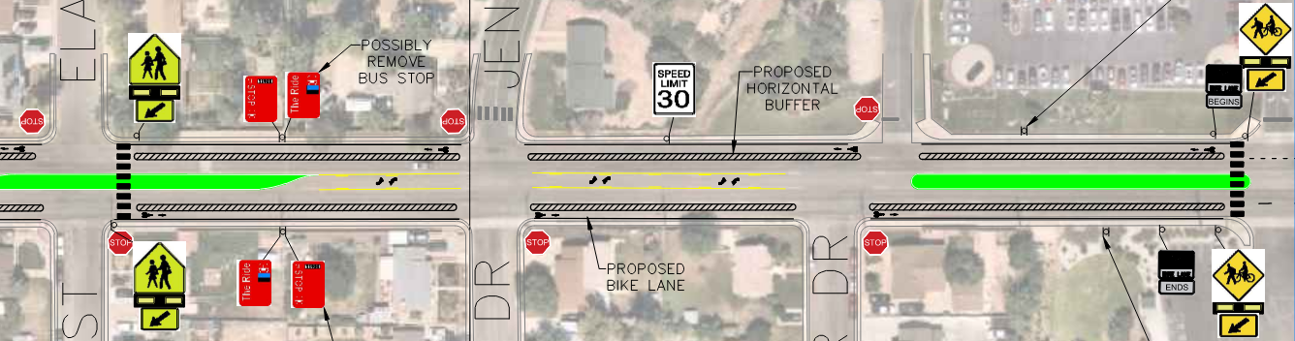
Alternative 2 3-Lane Section, Median/Center Turn Lane & Road Diet, Two-Way Buffered Bike Lanes
Pecos – Lipan Lipan – Huron
Huron - Broadway

Slide 14
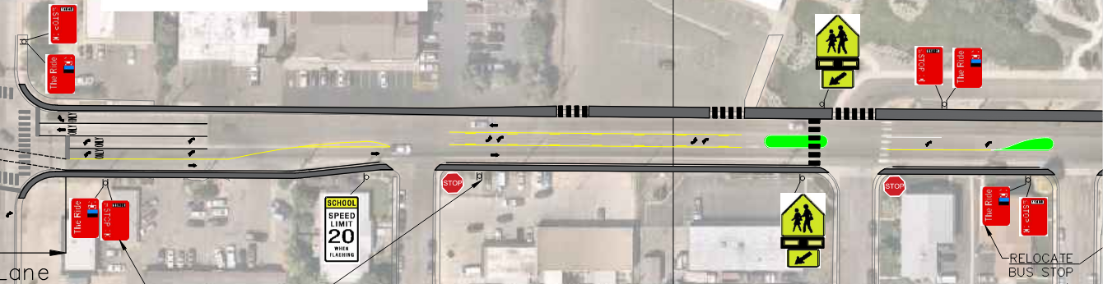
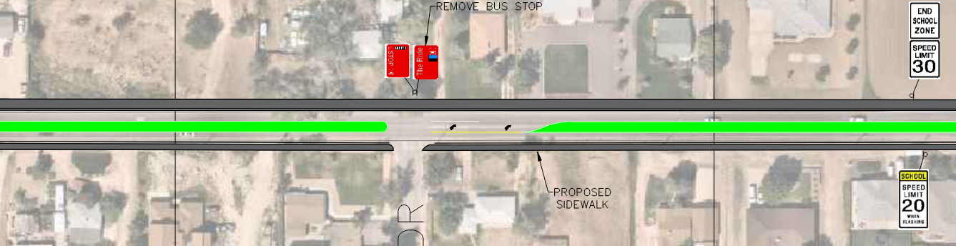
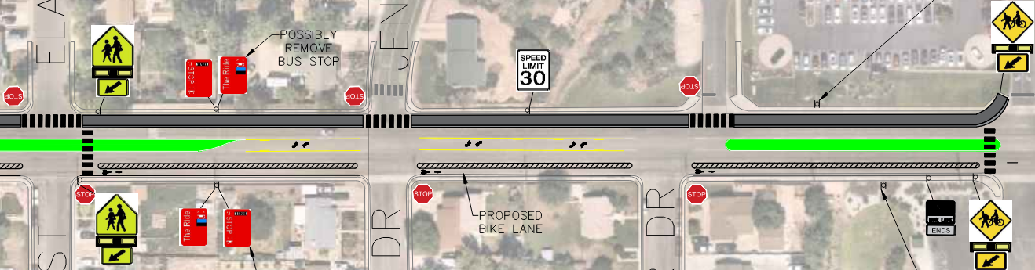
Alternative 2A 3-Lane Section, Median/Center Turn Lane & Road Diet, One-Way Bike Lane/Shared Use Path
Pecos – Lipan Lipan – Huron
Huron - Broadway

Slide 15
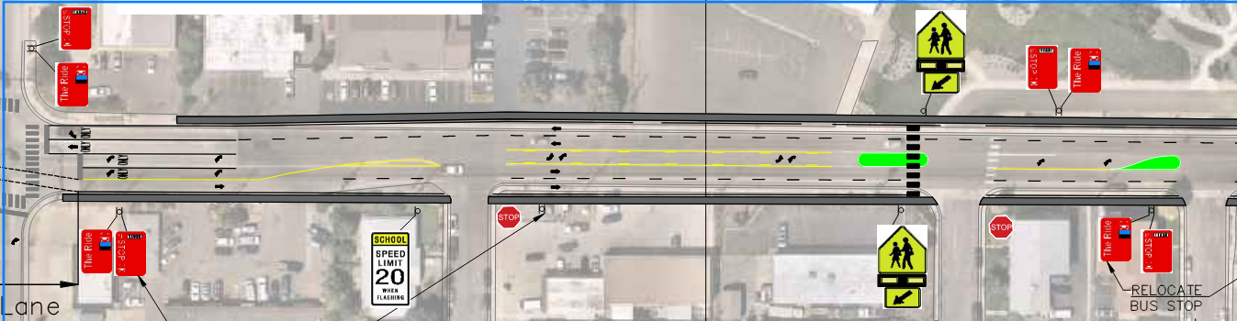
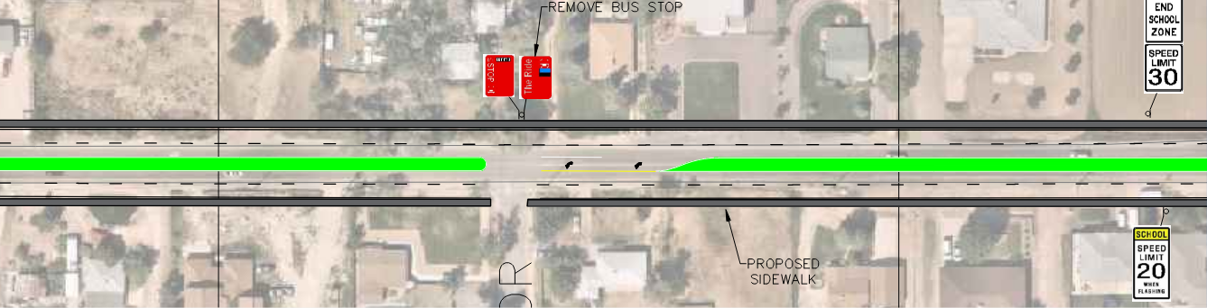
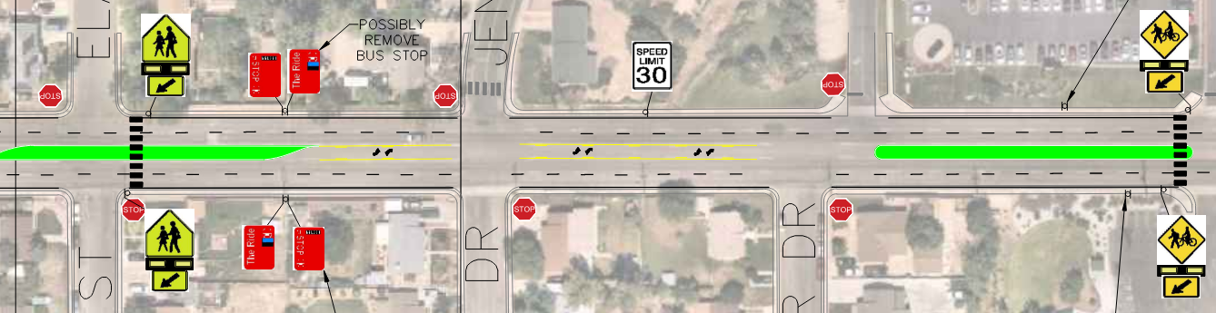
Alternative 3 5-Lane Section (County Standard)
Pecos – Lipan Lipan - Huron
Huron - Broadway

Slide 16
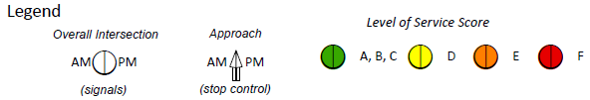
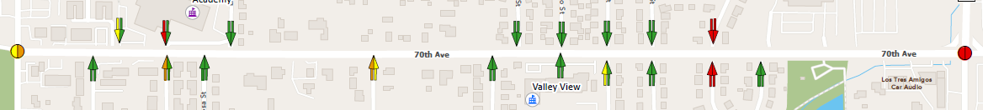
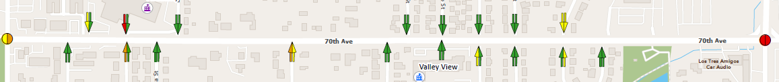
Level of Service
Alt.1
& 1A
Alt.2
& 2A
Alt.3
No
Build
Notes:
2045

Slide 17
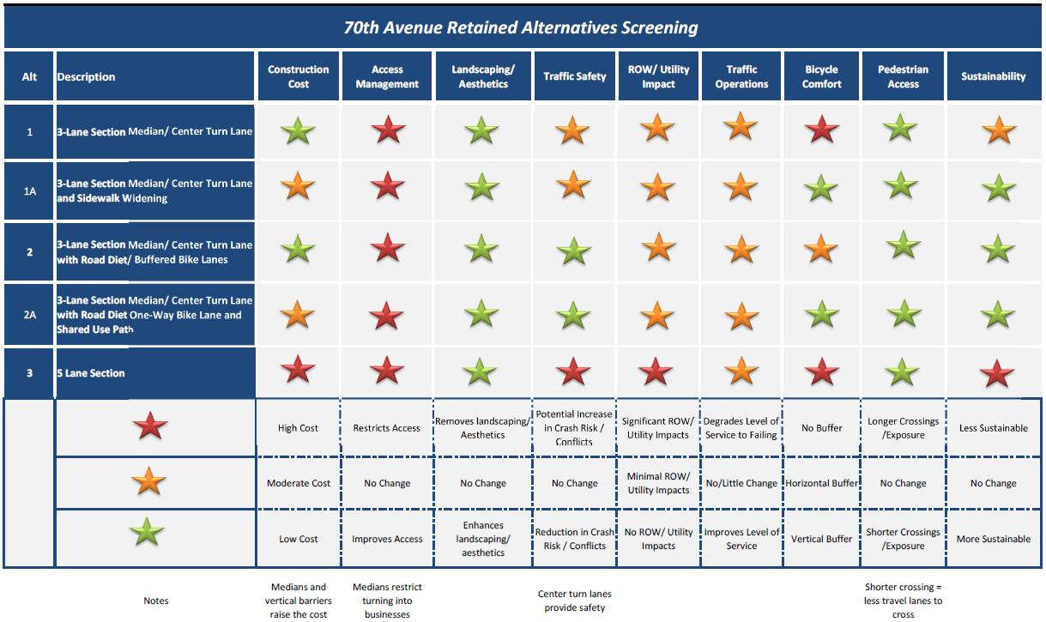
Screening Matrix

Slide 18
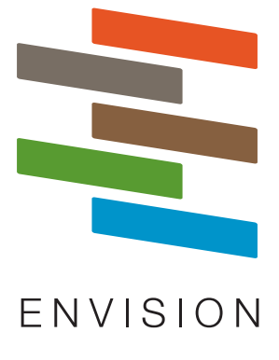
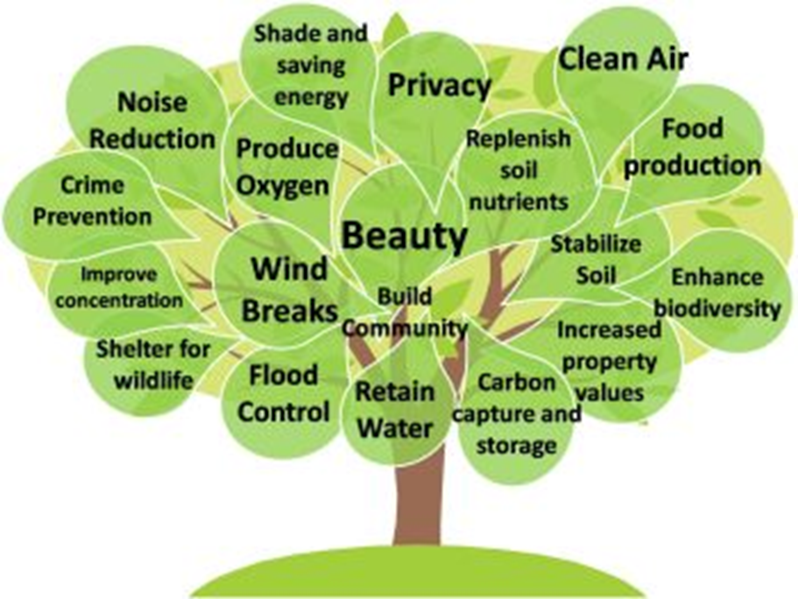
Sustainability in Design & Construction
This project will incorporate a variety of sustainable elements:
Envision process: sustainability goals
Tree Amenity Program
Low-impact drainage design & development
Notes:
Amy
So lets jump right in…What is Envision?
Envision is a framework used to assess sustainability and resilience in infrastructure.
Envision engages stakeholders, including owners, planners, engineers, and impacted communities; it considers social, economic and environmental factors, and can be tailored to individual projects
Envision is to be utilized at all stages of a project...from planning/concept through design and construction, and on to operation of the project. Although the earlier in a project the ENV process is started, the more credits are possibly available and the more the project team is able to truly integrate R/S in the project

Slide 19
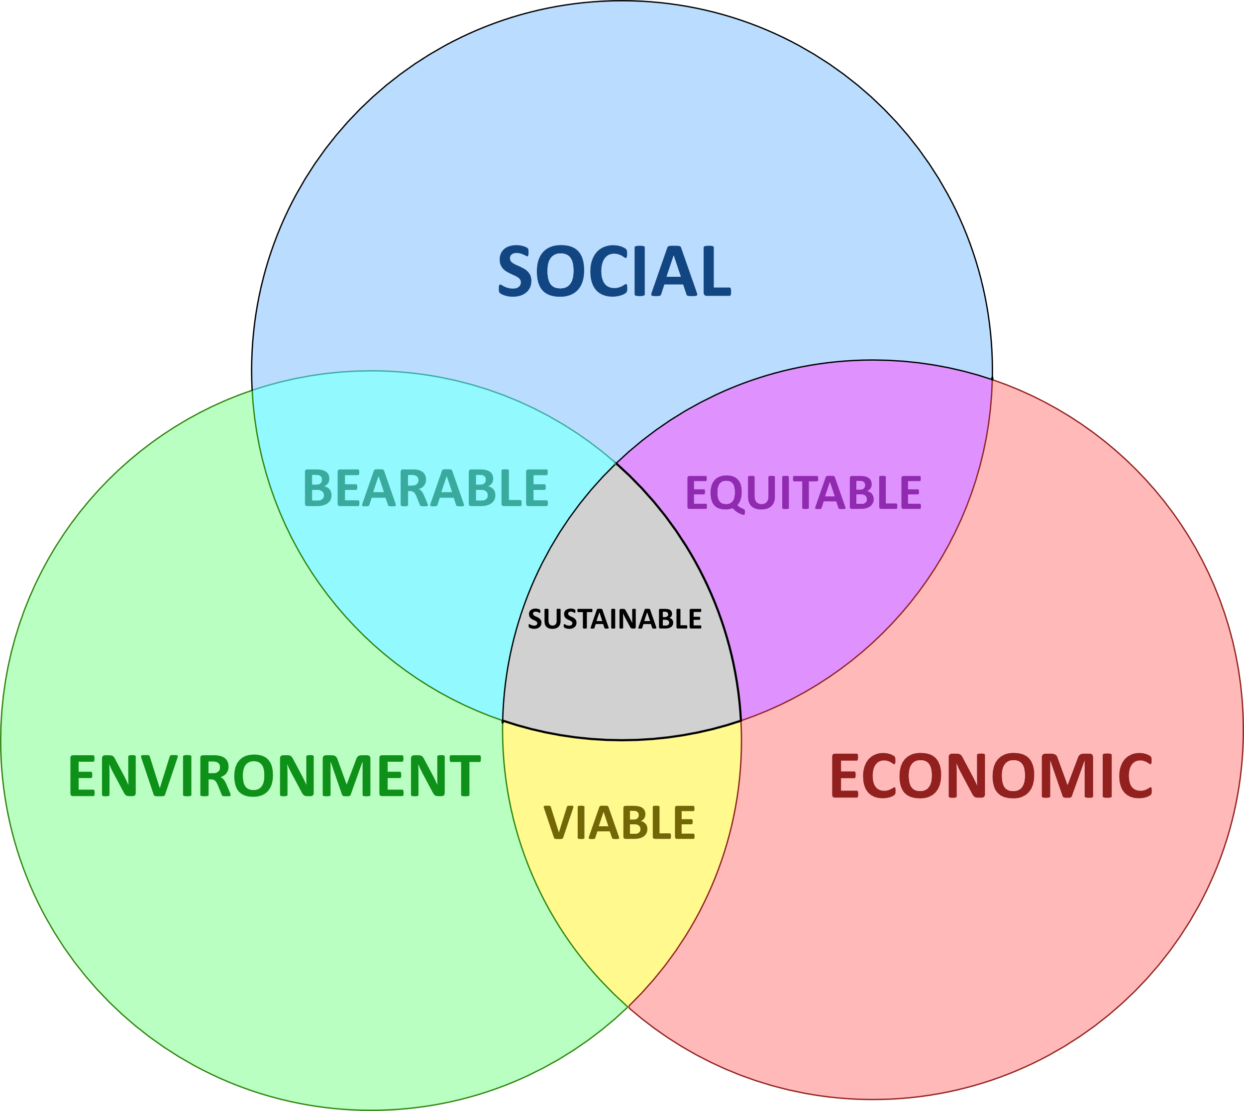
Sustainability
Definition:
meeting the needs of the present without compromising the ability of future generations to meet their own needs.

Slide 20
Sustainability Goals for this Project
Plant more trees than are removed
Maximize participation in Tree Amenity Program
Tree offered to property owner at no cost
Installed by project and becomes the responsibility of owner
Reduce water use
Offer rain barrels, utilize tree watering systems, etc.
Manage Stormwater
Expand water quality options like bioswales, rain gardens, low-water and native landscaping, cascade outlets, etc.

Slide 21
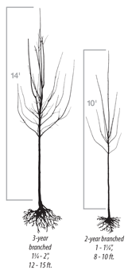
Adams County Tree Amenity Program
Sign Agreement with Public Notary
Tree: Select top 3 choices
Email: stormwater@adcogov.org
Deadline: by Project Bid
Tree to be installed by the County/Contractor on Private Property, frontage road side
Tree to be maintained and watered by Property Owner
Tree size: 1 inch caliper = 8-10 ft height

Slide 22
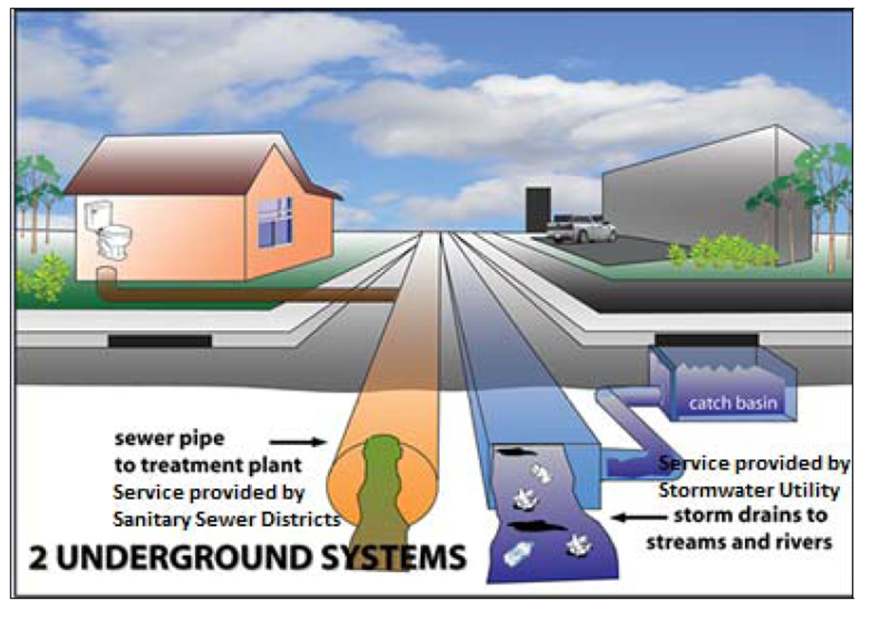
Understanding Types of Wastewater
Sanitary Sewer
Storm Sewer

Slide 23
Feedback
Do the alternatives address your concerns about ‘existing issues’ on the corridor?
Which alternative is your preferred design? (select 1)
What comments or questions do you have about these alternatives?

Slide 24
Thank you for attending the second public meeting for W. 70TH AVENUE: PECOS ST TO BROADWAY
Long Nguyen, Adams County, County Project Manager, LHNguyen@adcogov.org
Nathan Silberhorn, Ayres, Consultant Project Manager, SilberhornN@AyresAssociates.com
Molly North, Mead & Hunt, Public Engagement Liason, Molly.North@MeadHunt.com

